Slide 1

Advanced Web Technologies Front: React #2
17/12/2018
ISEP: React #2

Slide 2
Reminder…
What we talked about last week…
Why using a Framework or a lib
Why React
Props
State
Components
All the basics!!!
ISEP: React #2

Slide 3
Good practices
What are the good practices when you work with React?
Writing a Component when it is necessary
Using PropTypes
Stateless components
Using the component lifecycle
Functional programming & immutability
Writing tests!
ISEP: React #2

Slide 4

React
Based on where we exactly left last week!
ISEP: React #2

Slide 5
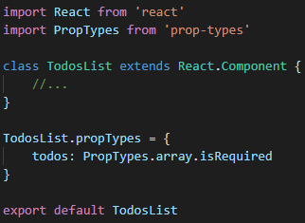
React: PropTypes
PropTypes are used to control the props of your components
Ex:
Thanks to this, we ensure that:
TodosList will always receive a todos prop
This todos prop will be an array
If not there will be an explicit warning
ISEP: React #2

Slide 6
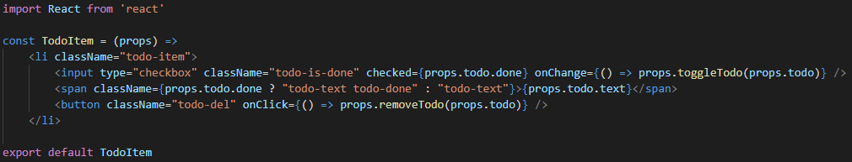
React: stateless components
An easier way to write components:
These types of components:
can’t have a state
can’t interact with lifecycles methods
ISEP: React #2

Slide 7
React: lifecycle methods
Mounting
constructor(props)
componentWillMount()
render()
componentDidMount()
Updating
componentWillReceiveProps(nextProps)
shouldComponentUpdate(nextProps, nextState)
componentWillUpdate(nextProps, nextState)
componentDidUpdate(prevProps, prevState))
Unmounting
componentWillUnmount()
Error handling
componentDidCatch(error, info)
Only Component classes can override a lifecycle method!
ISEP: React #2

Slide 8
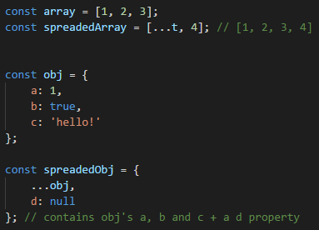
React: functional programming
Why functional programming?
Try to only write functions…
…and constant objects!
It will reduce bug possibilities.
The spread operator
Unary « … »
It will deconstruct your objects or arrays…
…without altering it!
Examples
ISEP: React #2

Slide 9
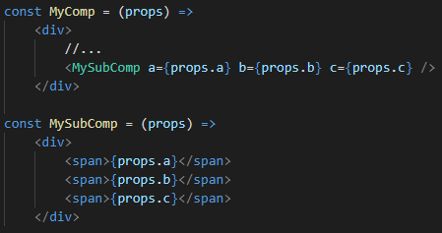
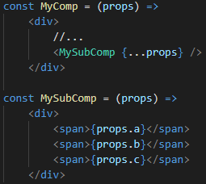
React: spreading props
Thanks to the spread operator, we can send multiple props easily in React:
ISEP: React #2

Slide 10

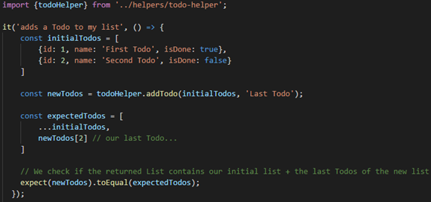
React: writing tests using Jest
create-react-app configures your test environment for you!
Just create a __tests__ folder inside your src folder…
Add every tests files you want…
And launch them using npm test command!
Example of test file:
ISEP: React #2

Slide 11


React: What’s next?
What we will see “next year”
Multiple pages management
Material-UI
ISEP: React #2

Slide 12

Today’s TP!
What you will have to do:
The show must go on! Take back your TP and improve it!
You will also have to call a server to search for your songs…
What will be evaluated:
Features correctly developed
Code quality !
Respect of good practices!
Tests quality !
Ergonomics/design
ISEP: React #2

Slide 13

That’s finally it! Have fun ☺
17/12/2018
ISEP: React #2

